Slide 1
CLAS 220 Introduction to Classical Mythology
Virgil, Aeneid 7-9

Slide 2
Quiz Question
Which goddess does Hippolytus revere?
Aphrodite
Artemis
Hera
Persephone

Slide 3
Quiz Question
2. Who encourages Phaedra in her illicit desire?
Hippolytus himself
Aphrodite
Her nurse
No one

Slide 4
Quiz Question
3. How will Phaedra get her revenge on Hippolytus?
By killing herself
By falsely accusing him of assaulting her
By killing him
Both A and B

Slide 5
Quiz Question
4. Which of the following happens to Hippolytus?
He loses control of his chariot
His father curses him
A bull attacks him from the sea
All of the above

Slide 6
Quiz Question
5. Who gives Theseus the curse he uses against his son?
Poseidon
Zeus
Hades
His Mother

Slide 7
Quiz Question
What is the name of the king whom Aeneas meets in Book 7? a. Lavinia
b. Latinus
c. Picus
d. Faunus

Slide 8
Quiz Question
2. Who is Aeneas’ rival for Lavinia’s hand in marriage?
Allecto
Mezentius
Lausus
Turnus

Slide 9
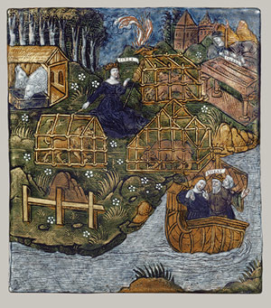
Caieta
Aeneas made his way
Straight to the ships to see his crews again,
Then sailed directly to Caieta’s port.
Bow anchors out, the sterns rest on the beach.
Nurse Caieta of Aeneas, in death you too
Conferred your fame through ages on our coast,
Still honored in your last bed, as you are,
And if this glory matters in the end
Your name tells of your grave in great Hesperia.
When he had seen Caieta’s funeral
Performed, her mound of tomb heaped up, Aeneas
Waited until the sea went down, then cleared
Her harbor under sail.
6.1219-7.9

Slide 10
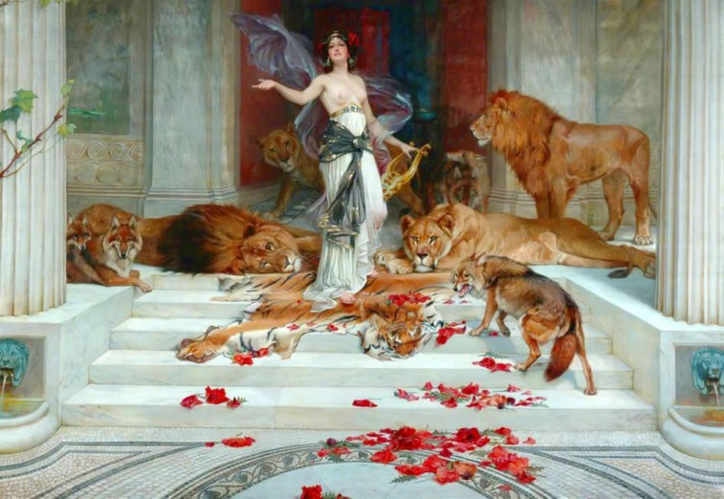
The path not taken
The soft south wind blew on, the white full moon
Left no sea-reach or path unbrightened for them, Shimmering on the open sea. They passed
The isle of Circe close inshore: that isle
Where, in the grove men shun, the Sun’s rich daughter Sings the hours away. She lights her hall
By night with fires of fragrant cedar wood,
Making her shuttle hum across the warp.
7.11-18
.

Slide 11
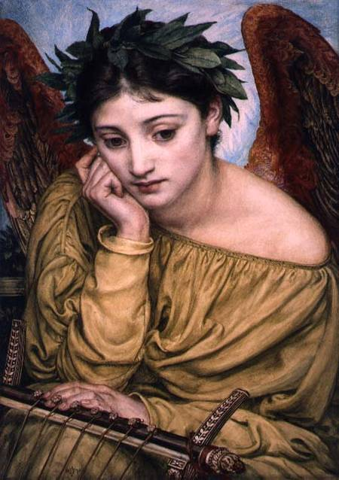
The Muse Invoked
Be with me, Muse of all Desire, Erato,
While I call up the kings, the early times,
How matters stood in the old land of Latium
That day when foreign soldiers beached
Upon Ausonia’s shore, and the events
That led to the first fight. Immortal one,
Bring all in memory to the singer’s mind,
For I must tell of wars to chill the blood,
Ranked men in battle, kings by their own valor
Driven to death, Etruria’s cavalry,
And all Hesperia mobilized in arms.
A greater history opens before my eyes,
A greater task awaits me.
7. 47-59

Slide 12
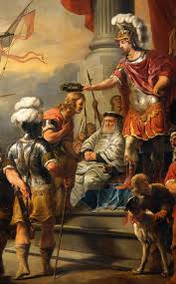
Introducing Latinus
King Latinus,
Now grown old, had ruled his settled towns
And countryside through years of peace.
Tradition Makes him a son of Faunus by a nymph,
Marica of the Laurentines. The father
Of Faunus had been Picus, who in turn
Claimed you for sire, old Saturn, making you
The founder of the dynasty. By fate
Latinus had no son or male descendant,
Death having taken one in early youth.
A single daughter held that house’s hopes,
A girl now ripe for marriage, for a man.
7. 60-71

Slide 13
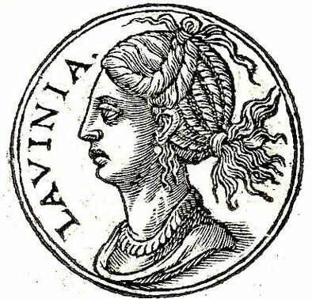
We Meet Lavinia
While the old king lit fires at the altars
With a pure torch, the girl Lavinia with him,
It seemed her long hair caught, her head-dress caught
In crackling flame, her queenly tresses blazed,
Her jeweled crown blazed. Mantled then in smoke
And russet light, she scattered divine fire
Through all the house. No one could hold that sight
Anything but hair-raising, marvelous,
And it was read by seers to mean the girl
Would have renown and glorious days to come
But that she brought a great war on her people.
7. 94-104

Slide 14
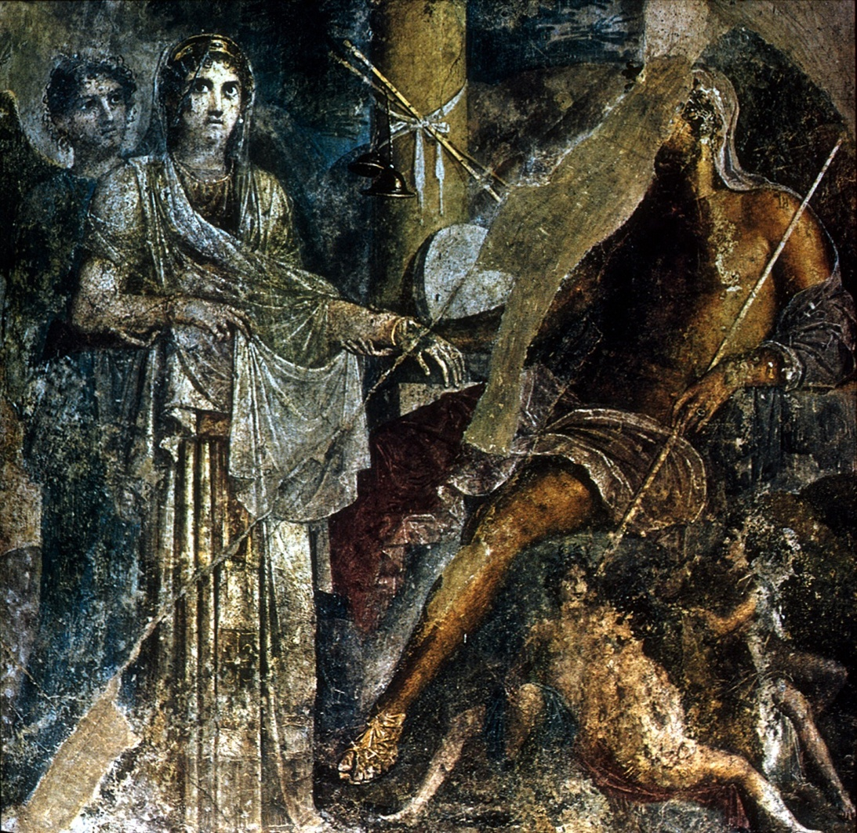
Juno Has a Cunning Plan
She dropped to earth
In a shuddering wind. From the dark underworld
Home of the Furies, she aroused Allecto,
Grief’s dear mistress, with her lust for war,
For angers, ambushes, and crippling crimes.
Even her father Pluto hates this figure,
Even her hellish sisters, for her myriad
Faces, for her savage looks, her head
Alive and black with snakes. Now Juno spoke
To excite her…
7. 442-451

Slide 15
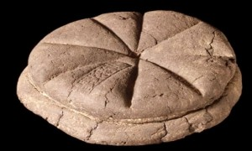
A prophecy fulfilled
There with his officers
And princely son, Aeneas took repose
Beneath a tall tree’s boughs. They made a feast,
Putting out on the grass hard wheaten cakes
As platters for their meal— moved to do this
By Jupiter himself. These banquet boards
Of Ceres they heaped up with country fruits.
Now, as it happened, when all else was eaten,
Their neediness drove them to try their teeth
On Ceres’ platters. Boldly with hand and jaw
They broke the crusted disks of prophecy,
Making short work of all the quartered loaves.
7.140-151

Slide 16
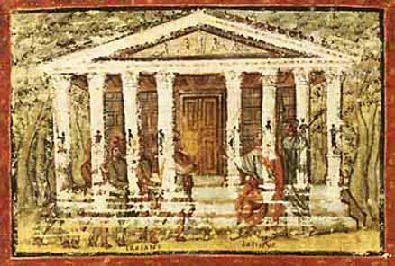
Latinus’ Palace
Meanwhile a messenger, riding ahead,
Reported to the old king the arrival
Of tall men in strange costume, and the king
Ordered them brought inside. He took his seat
Amid the court, on his ancestral throne.
The royal building, massive and majestic,
Raised on a hundred columns, occupied
The city’s height. It had been Picus’ palace,
Shadowed by trees and history, held in awe.
7.222-230

Slide 17
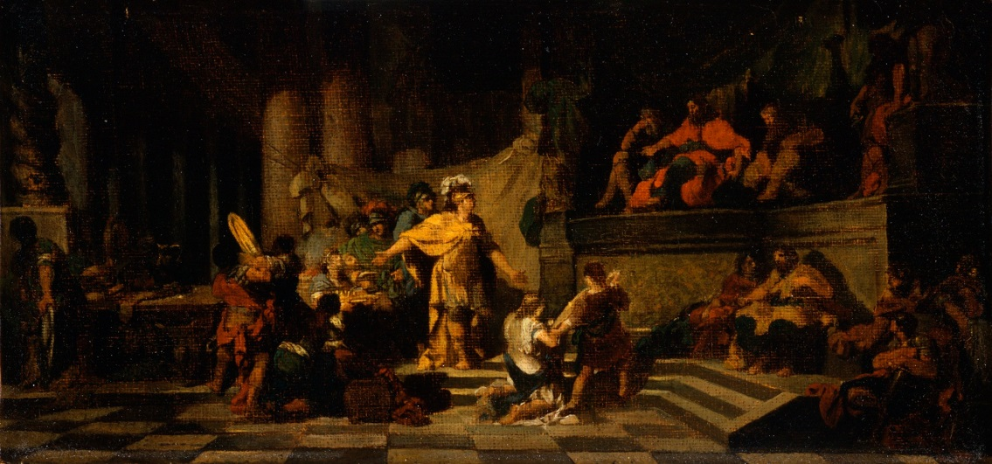
Aeneas asks a favour
By that storm overwhelmed, and then at sea
So long on the vast waters, now we ask
A modest settlement of the gods of home,
A strip of coast that will bring harm to no one,
Air and water, open and free to all.
We will not shame your kingdom. You shall win
No light and passing fame, nor from ourselves
A passing gratitude for your kind act.
7.303-310

Slide 18
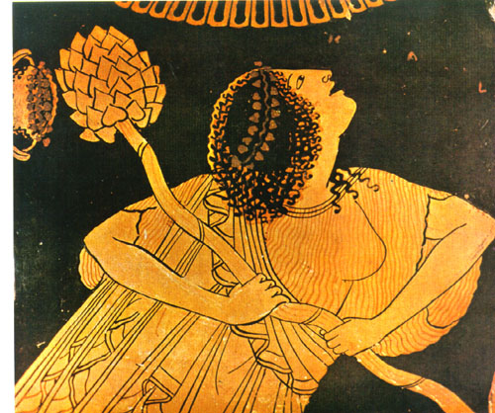
Amata Goes Wild
The serpent’s evil madness circulated,
Suffusing her, the poor queen, now enflamed
By prodigies of hell, went wild indeed
And with insane abandon roamed the city.
One sees at times a top that a wound-up thong
Snapped into a spin, when, all eyes for the sport,
Boys drive it round a court in a great circle,
Sweeping curves on the ground, flicked by the whip…
Worse, she feigned
Bacchic possession, daring a greater sin
And greater madness. Off to the woods she ran.
Into the leafy hills, and hid her child
To snatch a marriage from the Teucrians
Or to postpone the wedding. “Evoe,
Bacchus, she shrilled out….
6.517-536

Slide 19
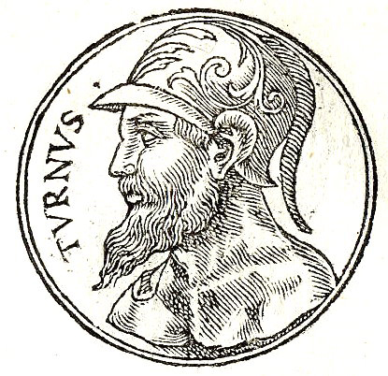
Turnus is Enraged
Allecto blazed in wrath,
And sudden trembling ran through the man’s body
Even as he spoke, his eyes in a rigid stare,
For now the Fury hissed with all her serpents,
All her hideous faces. Glancing round
With eyes of flame, as the man’s faltering tongue
Tried to say more, she threw him back and raised
A parir of snakes out of her writhing hair…
With this she hurled a torch and planted it
Below the man’s chest, smoking with hellish light.
Enormous terror woke him, a cold sweat
Broke out all over him and soaked his body. Then driven wild, shouting for arms, for arms,
He ransacked house and chamber. Lust of steel
Raged in him, brute insanity of war,
And wrath above all…
7. 614-636

Slide 20
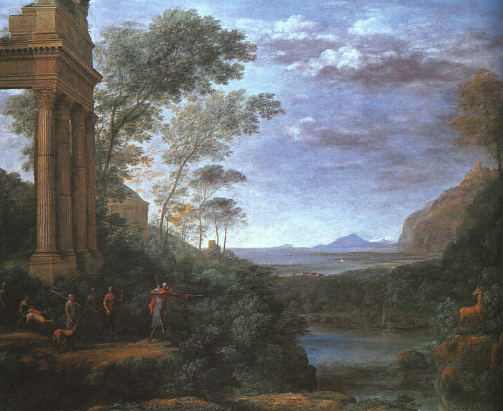
Ascanius/Iulus Shoots the Wrong Deer
Ascanius himself, now on the chase
And passionate for the honor of the kill,
Let fly a shaft from his bent bow: Allecto’s
Guidance did not fail his hand or let him
Shoot amis, and the arrow whizzing loud
Whipped on to pierce the belly and the flank.
Mortally hurt, the swift deer made for home
In the farm buildings. Groaning, he found his stall,
And coated with dark blood he filled the house
With piteous cries, as though imploring mercy.
Hugging her shoulders, beating with her hands,
The sister, Silvia, raised a cry for help…
6.681-692

Slide 21
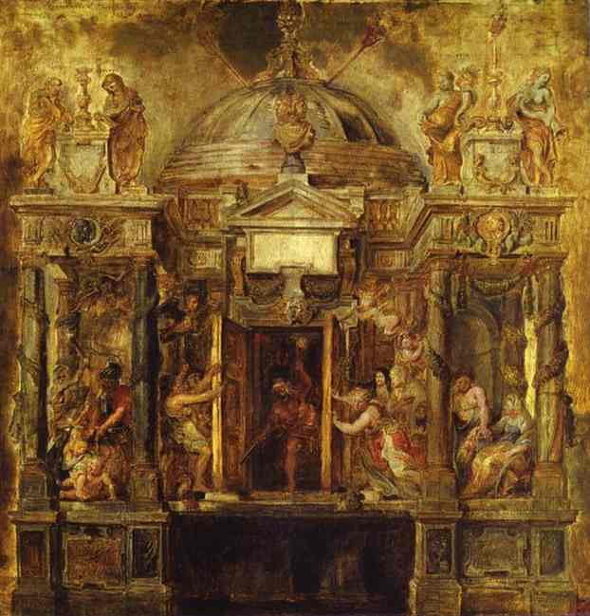
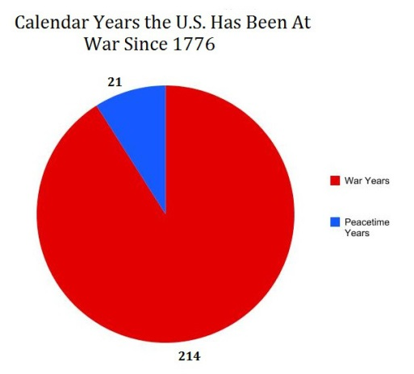
Latinus Refuses to Shut the Gates of the Temple of Janus
There are two gates, twin gates
Of war, as they are called, by long observance
Looked on in awe, for fear of savage Mars.
One hundred brazen bolts keep these gates closed
And the unending strength of steel; then too
Their guardian, Janus, never leaves the portal.
Now when the Fathers’ judgment holds for war,
The Consul in Quirinal robe and Gabine
Cincture goes to unlock the grating doors
And lifts a call for battle. Fighting men
Then add their voices, and the brazen trumpets
Blown together blare their harsh assent.
In that way, now, Latinus was enjoined
To declare war on the people of Aeneas
By setting wide the grim gates. But he would not,
Would not touch them, only turned away
From the repellent work, and shut himself
In the interior darkness.
7. 834-851

Slide 22
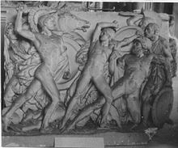
Catalog of Latin Allies
Muses, now
Throw wide the gates of Helicon, your mountain,
Now lift up your song, to tell what kings
Were stirred to war, what troops in each command
Filled all the lowlands, fighting men in whom
Even in those days bounteous Italy
Had come to flower, in whom her spirit blazed.
For you remember, you can bring to life
That time, immortal ones, while to ourselves
Faint wraiths of history barely transpire.
First to equip a troop and take the field
Was harsh Mezentius of Tuscany,
Who held the gods in scorn. The son who rode
Beside him, Lausus, unexcelled in beauty
Except by Turnus of the Laurentines—
Horse-tamer Lausus, conqueror of beasts—
Led from Agylla’s town a thousand men…
7.880-895

Slide 23
Quiz Question
3. Which Greek-speaking king does Aeneas seek as an ally in his war with the Latins?
Evander
Apollinus
Pallas
Euryalus

Slide 24
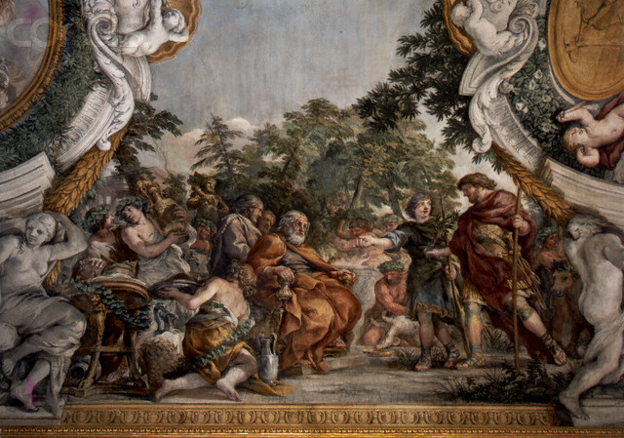
Aeneas Meets Evander in Future Rome
“I have not feared you as Arcadian
Or captain of the Danaans, or blood-kin
Of the Atridae. No, my own manhood
And heaven’s holy words, our ancestry
In common, and your fame through all the world,
Have brought me here by destiny, and gladly,
To join my strength with yours. The Greeks maintain
Electra bore the founding father of Troy,
Old Dardanus, who sailed to the Teucrians….
8. 175-183

Slide 25
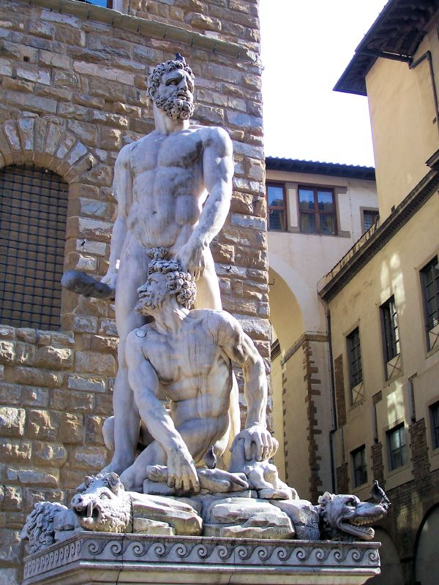
Hercules and Cacus
“O thou unconquered one, who slew the centaurs,
Pholus and Hylaeus, born of cloud,
And broke the Terror of Crete by thy right hand
And killed the lion under Nemea’s crag!
Before thee shook the Stygian lakes, the Keeper
Of Orcus shook, sprawled in his gory cave
On bones partly devoured. No monstrous form
Affrighted the, even Typhoeus’ self
Though mountainous in arms. And Lerna’s hydra
Coiling about thee with a swarm of heads
Attacked no guileless warrior. Hail to thee,
True son of Jove, new glory of the gods,
With friendly stride come join us, join thy feast.!”
So ran the hymns they sang, and crowning all
A song of Cacus’ cave and breath of fire –
Voices that filled the leafy wood, and rang,
And sprang back from the echoing hill-sides.
8. 388-404

Slide 26
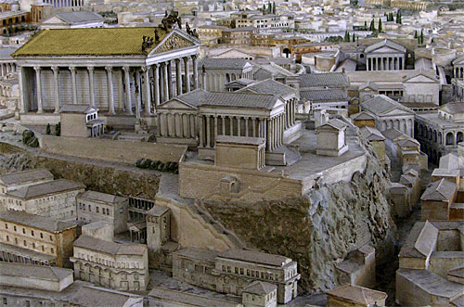
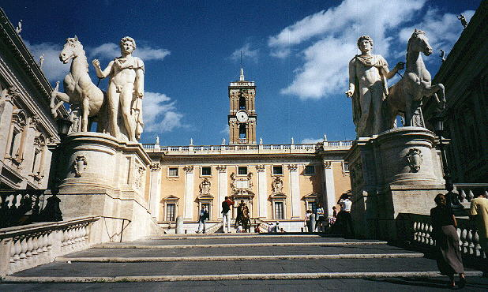
Aeneas Tours the Future
Then King Evander, founder unaware
Of Rome’s great citadel, said: These woodland places
Once were homes of local fauns and nymphs
Together with a race of men that came
From tree trunks, from hard oak: they had no way
Of settled life, no arts of life, no skill
At yoking oxen, gathering provisions,
Practising husbandry, but got their food
From oaken boughs and wild game hunted down.
In that first time, out of Olympian heaven,
Saturn came here in flight from Jove in arms…
From there
He led to our Tarpeian site and Capitol,
All golden now, in those days tangled, wild
With underbrush – but awesome even then.
A strangeness there filled country hearts with dread
And made them shiver at the wood and Rock.
8. 413-424; 458-463

Slide 27
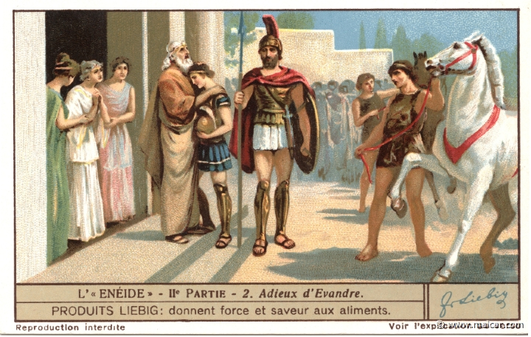
Evander commits his son to war
Enter on your great duty now, great heart,
Commander of Trojans and Italians both!
I shall, besides, commit to you my Pallas,
All my comfort and my hope, to learn
With you as master how to weather battle,
Mars’ dead serious work. May he become
Familiar with your actions, look to you
As his exemplar from his early years.
I’ll add two hundred horsemen, all Arcadians,
Picked for ruggedness. In his own name
Pallas will give two hundred more.”
7.694-704

Slide 28
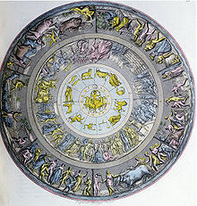
The Shield of Aeneas
There the Lord of Fire,
Knowing the prophets, knowing the age to come,
Had wrought the future story of Italy,
The triumphs of the Romans: there one found
The generations of Ascanius’ heirs,
The wars they fought, each one…
8. 848-853

Slide 29
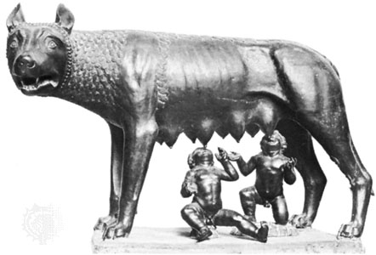
The Shield: Romulus and Remus
Vulcan had made
The mother wolf, lying in Mars’ green grotto;
Made the twin boys at play about her teats,
Nursing the mother without fear, while she
Bent round her smooth neck fondling them in turn
And shaped their bodies with her tongue…
8. 853-59;

Slide 30
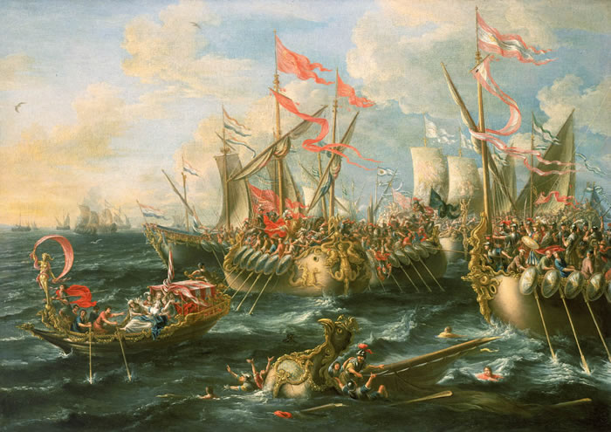
The Shield: Actium
Vivid in the center were the bronze-beaked
Ships and the fight at sea off Actium.
Here you could see Leucata all alive
With ships maneuvering, sea glowing gold,
Augustus Caesar leading into battle
Italians, with both senators and people,
Household gods and great gods: there he stood
High on the stern, and from his blessed brow
Twin flames gushed upward….
8.912-920

Slide 31
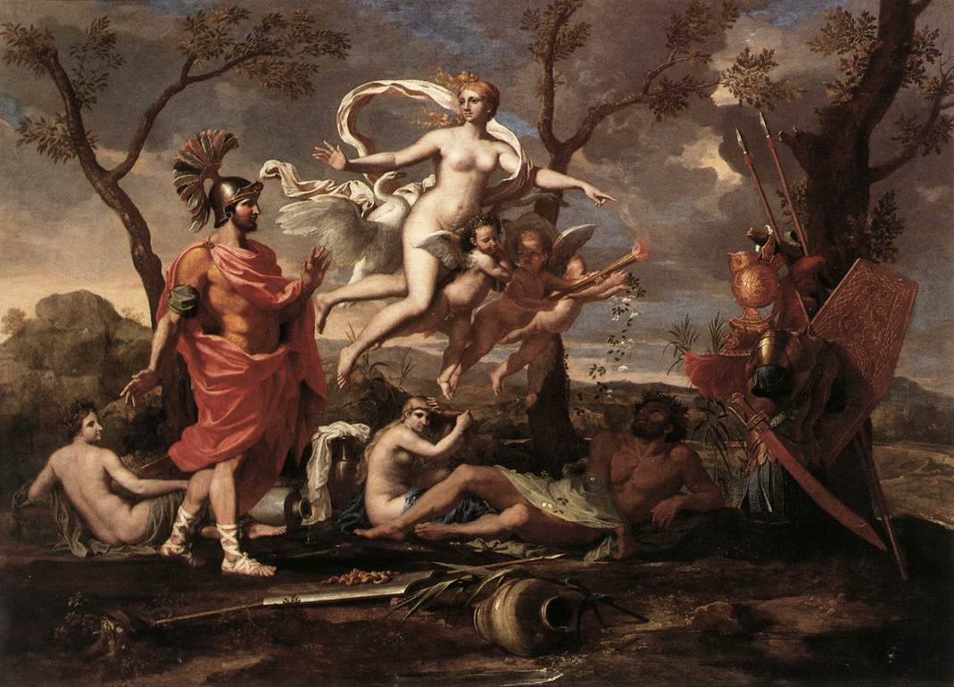
Aeneas takes his shield
All these images on Vulcan’s shield,
His mother’s gift, were wonders to Aeneas.
Knowing nothing of the events themselves,
He felt joy in their pictures, taking up
Upon his shoulder all the destined acts
And fame of his descendants.
8. 987-992

Slide 32
Quiz Question
4. Which two heroes participate in a night raid on the Latins in the Aeneid?
Pyramus and Thisbe
Odysseus and Diomedes
Nisus and Euryalus
Castor and Pollux

Slide 33
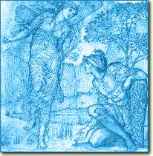
Juno Sends Iris to Turnus
“Turnus, what no god
Would dare to promise you – your heart’s desire –
The course of time has itself brought on.
Leaving his town and ships and followers
Aeneas journeyed to the Palatine
Court of Evander. Still unsatisfied,
He’s gone to distant hamlets of Corythus
To rally and arm the Lydian countrymen.
Why hesitate? Now is the time to sound
The call for cavalry and war-cars, now!
Break off this lull, strike at their flurried camp,
Take it by storm!” On even wings she rose
Into the sky, inscribing her great bow
In flight upon the clouds. He knew her sign,
And lifting both his hands to starry heaven…
9. 7-23

Slide 34
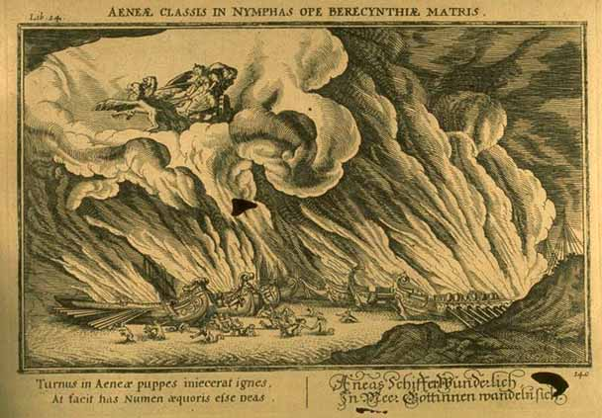
The Ships Escape
“No desperate rallying to defend my ships,
You Trojans, no equipping men for that.
Turnus may sooner fire the sea itself
Than hulls of holy pine. Ships, now go free,
Go as sea-goddesses. Your Mother sends you.”
Each broke her hawser instantly; their bows
Went under like a school of dolphins diving
Into the depths, then wondrously came up,
So many virgin forms now seaward bound.
9. 162-170

Slide 35
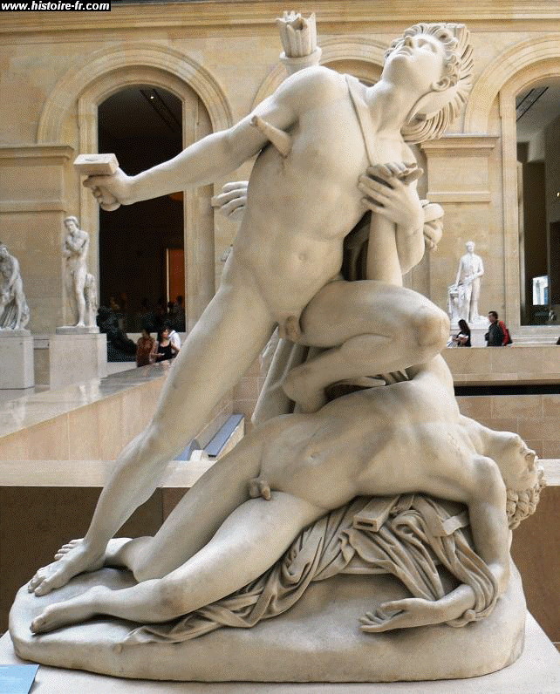
Nisus and Euryalus Go On a Night Raid
… ordering Nisus to speak out. He did so,
Saying: “Soldiers of Aeneas, listen
With open minds, and let what we propose
Be looked on without reference to our years.
The Rutulians have quieted down. Their wine
Has put them all to sleep. But we make out
An opening for a sortie where the road
Divides there at the gate nearest the sea,
A gap at that point in their line of fires
With only black smoke rising. If you let us
Take advantage of this to find our way
To Aeneas and Pallanteum, you’ll see us back
With plunder before long, and slaughter done.
No fear the path will fool us; many times,
Hunting in these valleys, we have come in view
Of the town’s outposts, and we know the river,
The whole course of it.”
9. 324-340

Slide 36
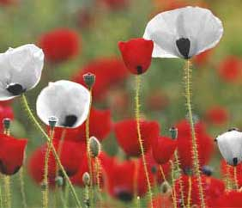
The Death of Euryalus
But while he clamored,
Volcens’ blade, thrust hard, passed through the ribs
And breached the snow-white chest. Euryalus
In death went reeling down,
And blood streamed on his handsome length, his neck
Collapsing let his head fall on his shoulder –
As a bright flower cut by a passing plow
Will droop and wither slowly, or a poppy
Bow its head upon its tired stalk
When overborne by a passing rain.
9.611-620

Slide 37
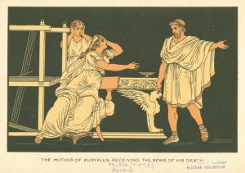
Euryalus’ Mother Laments
“Must I see you
Even like this, Euryalus? You that were
In these last days the comfort of my age
Could leave me, could you, cruel boy, alone?
Sent into danger so, had you no time
For your poor mother’s last farewell? Ah, god,
You lie now in a strange land, carrion
For Latin dogs and birds, and I your mother
Never took you – your body – out for burial,
Nor closed your eyes nor washed your wounds nor dressed you
In the fine robe I had been weaving for you
Night and day, in haste, before the loom,
Easing an old woman’s pain. But where
Shall I go now? Where is the earth that holds
Your trunk dismembered, all your mangled body?
This – is this all of yourself, my son,
That you bring back to me? By sea and land
Did I keep this beside me? Put your spears
Into me, Rutulians, if you can be moved,
Let fly your javelins all at me, and let me
Be the first you kill…
9.680-701

Slide 38
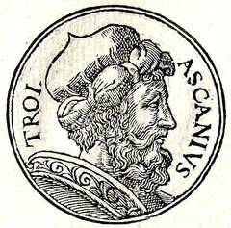
Ascanius’ First Blood
At that moment in the quarter of high air
Apollo with flowing hair, from a throne of cloud,
Looked down upon Ausonian troops and town.
He spoke to the victor, Iulus: “Blessed be
Your new-found manhood, child. By striving so
Men reach the stars, dear son of gods
And sire of gods to come. All fated wars
Will quiet down, and justly, in the end
Under descendants of Assacrus,
For Troy no longer bounds you.”
9. 888-898

Slide 39
Quiz Question
5. What is the name of Latinus’ wife?
Lavinia
Amata
Allecto
Camilla

